Slide 1

https://www.uni-goettingen.de/en/48115.html
Unless I explicitly state otherwise, images and cartoons are created using ChatGPT.
You may use this material free of charge under the terms of the CC BY license. This requires that you provide appropriate attribution to the author: W. Link, University of Goettingen, Germany.
In a few cases, individual images, photographs, or similar material may be subject to a more restrictive Creative Commons license. Where this applies, it is explicitly indicated, and you must comply with the stated license terms for those items.
Please check the license information carefully before reuse. Responsibility for complying with the applicable license terms rests entirely with you.
UNPLAB-BrMeth_Ch-7[RecSel.III]
Recurrent Selection III
1

Slide 2
Sequential Number: #25
UNPLAB-BrMeth_Ch-7[RecSel III]
2

Slide 3
You already know:
Population Genetics. This mean pertinent items and topcis such as
Genotype frequency, Allele frequency, Hardy-Weinberg-Equilibrium, Inbreeding coefficient,
Kinship (this one, for instance, find it in „PopGen_Ch-3[Inbreeding]“; in about page 29 there);
Selection, Drift, Migration, Mutation.
You have studied the chapters on Genotype x Environment Interactions and the Breeder’s Equation.
And you have already studied two chapter about Recurrent Selection (BrMeth_Ch-5 and BrMeth_Ch-6).
Keywords of this chapter:
Allocation of resources in a combined Fullsib and S1-line Recurrent Selection Program in Sorghum breeding.
General considerations of short- and long-term gain in Recurrent Selection. Role of Selection Unit, Test Unit, Recombination Unit.
Algebra as introduced in this chapter: None.
3

Slide 4
We have to admit that in all these methods of recurrent selection, we did not specify any numbers; we so far ignored a topic named ‘Allocation of Resources’.
How many plants to take as candidates? If we have field-based progeny-testing, then ... plot size, number of replications, number of locations and seasons for the field tests? How strict to select? How exactly to recombine?
How many cycles to go unless new (alien) material is drained into the germplasm; or unless cultivar development can be started?
More questions linger backstage ;-)
Let us, to come nearer to reality, at least add Allocation data ...
4
https://s.gwdg.de/erbR6w

Slide 5
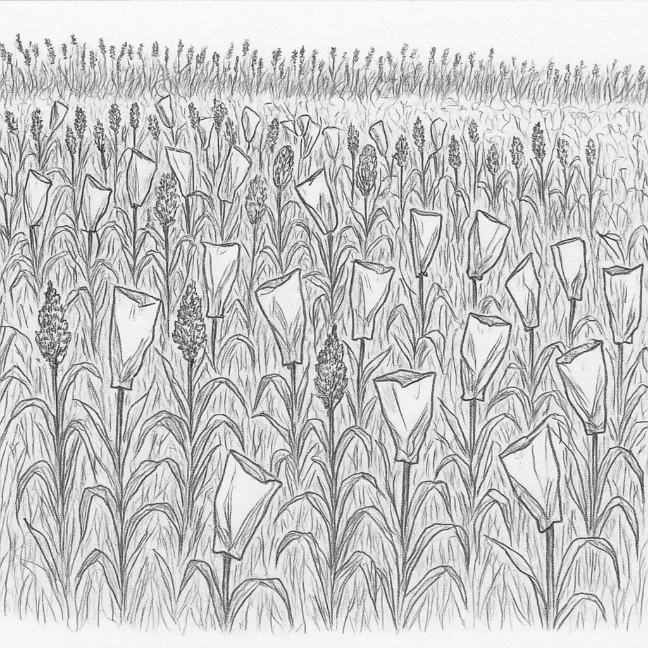
[VIII] Combined Fullsib and S1-line recurrent selection.
The last one of the 8 recurrent selection methods to which we have patiently devot-ed ourselves here ;-)
(Schipprack, 1993; https://s.gwdg.de/bzK9MF)
Recom-
bine
Extract cultivar
Cultivar
5

Slide 6
[VIII] Combined Fullsib and S1-line recurrent selection
Base population: Cross N₁
pairs of individuals.
Optimized* for sorghum.
N₁=280; N₂=45; N₃=5; N₄=35;
one cycle = 4 seasons.
*This is just intended to raise awareness of the issue of Resource Allocation; therefore, I will not go deep into detail about aspects such as budget, germplasm, characteristics, geographi-cal region, etc.
Evaluate N₁ fullsibs at 2 locations,
select N₂ best; produce N₃ S₁-lines
per fullsib (selfing).
Evaluate N₂∙N₃ S₁-lines,
select N₄ best of them.
Use remnant seed to
Diallel cross N₄ best S₁-lines.
Recom-bine
Further improve population
and/or extract cultivar
Cultivar
6

Slide 7
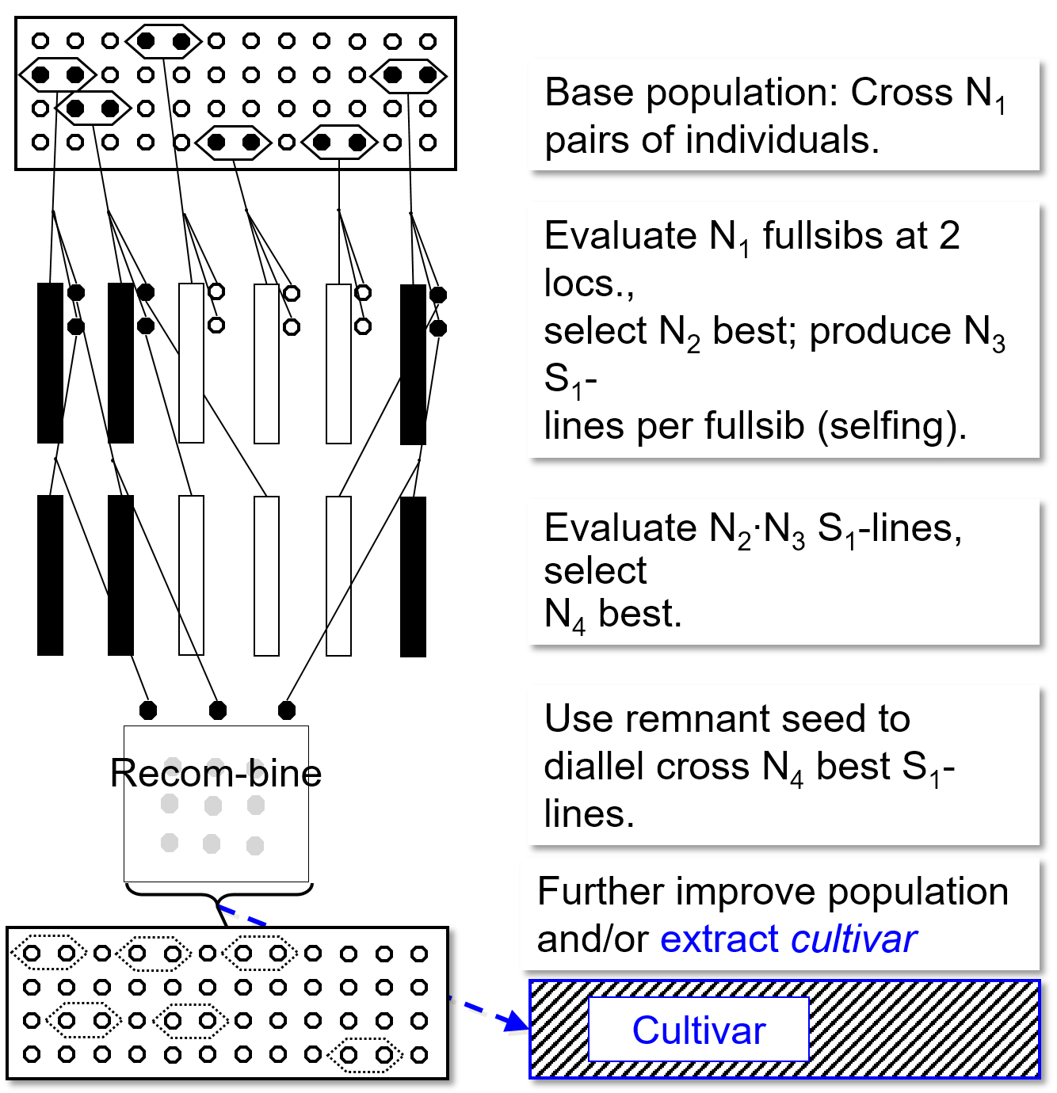
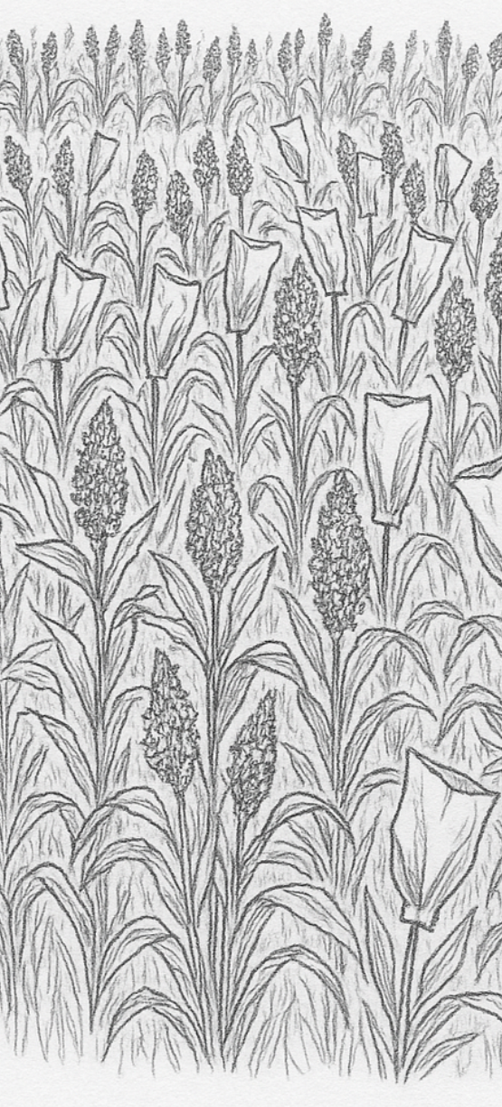
Combined Fullsib (FS) and S1-line recurrent selection.
Choose at random (or with selection) pairs of plants for bagging-based crossing (tech-nique depends: natural outcrossing; hot water technique, plastic bag technique for manual crossing, CMS, gametozide, MS). Test FS in plots at 2 locations and, from spare seed, self-fertilize 5 random indivi-duals per FS. Select 45 (≙16%) best FS, test the 5 x 45 = 135 S1-lines that represent them at 3 locations. Select 35 (≙26%) best S1-lines. Recombine them from remnant seed (that was not sown for testing them). How many individuals represent one S1-line when recombining (producing crossed seed for next season of new pair-crosses)?
Evaluate N₁ fullsibs at
2 locs., select N₂ best; produce N₃ S₁-lines per fullsib (selfing).
Evaluate N₁∙ N₂ S₁-lines, select N₄ best.
This method (one cycle = 4 seasons) was optimized with due attention to genetic para-meters (variances, covariances) of a specific Sorghum bicolor germplasm and with yield as sole trait, and with data on cost for labour, for field, for lab etc.
Result for one of various modelled options:
N1=280; N2=45; N3=5; N4=35. Results for ‘your’ breeding will be different. Alas.
7

Slide 8
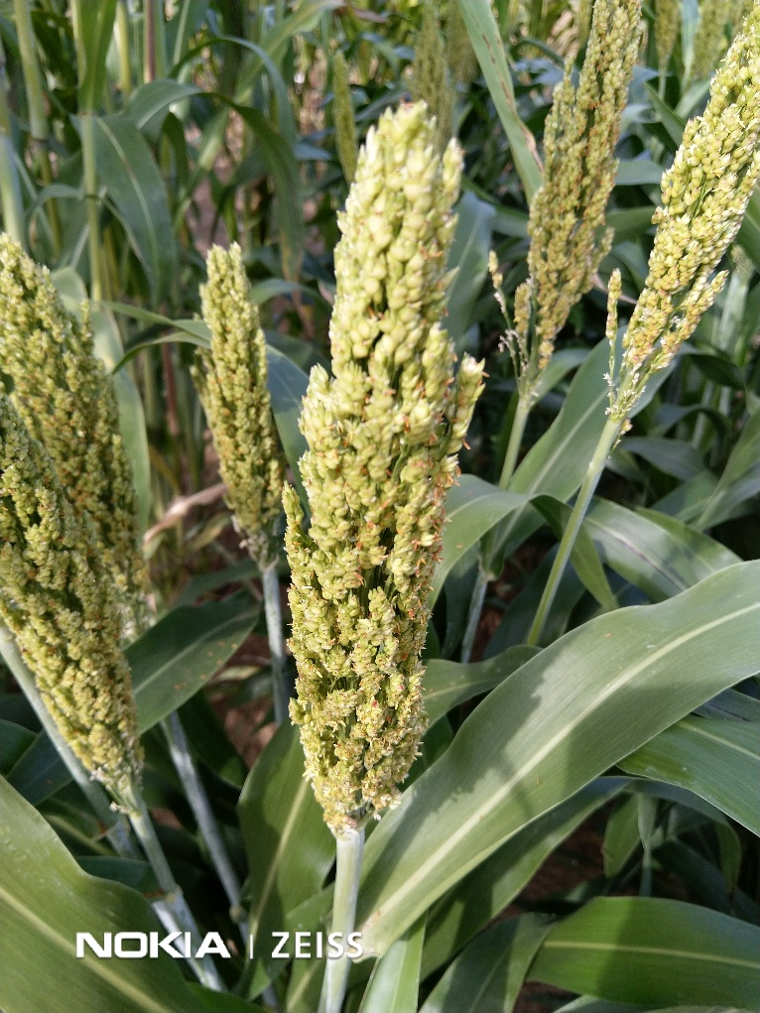
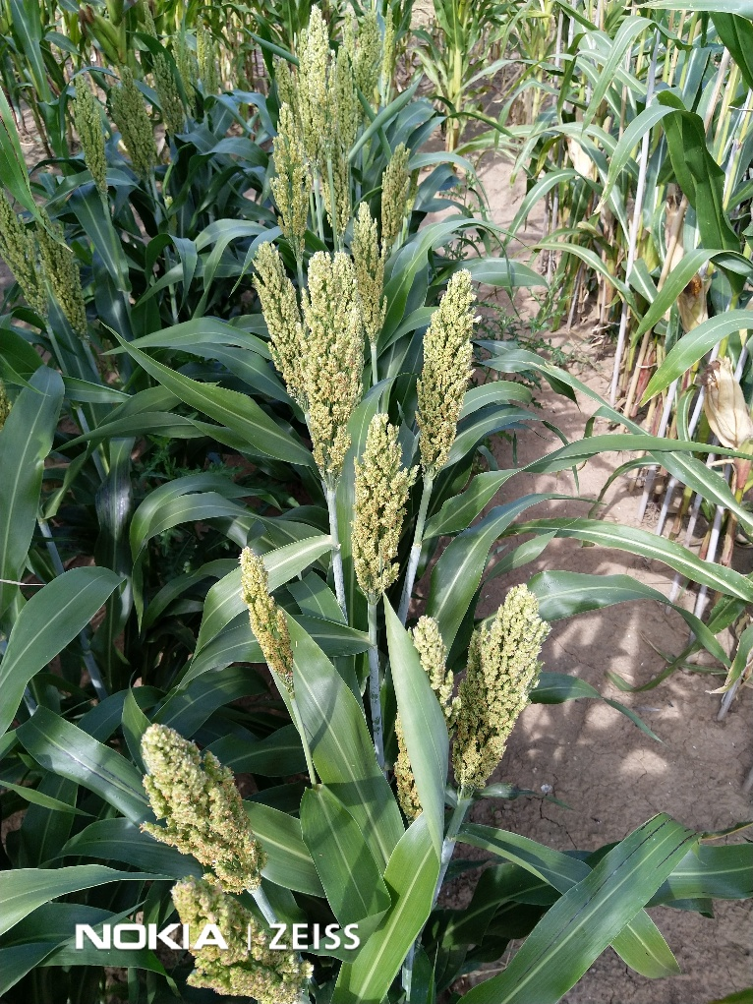
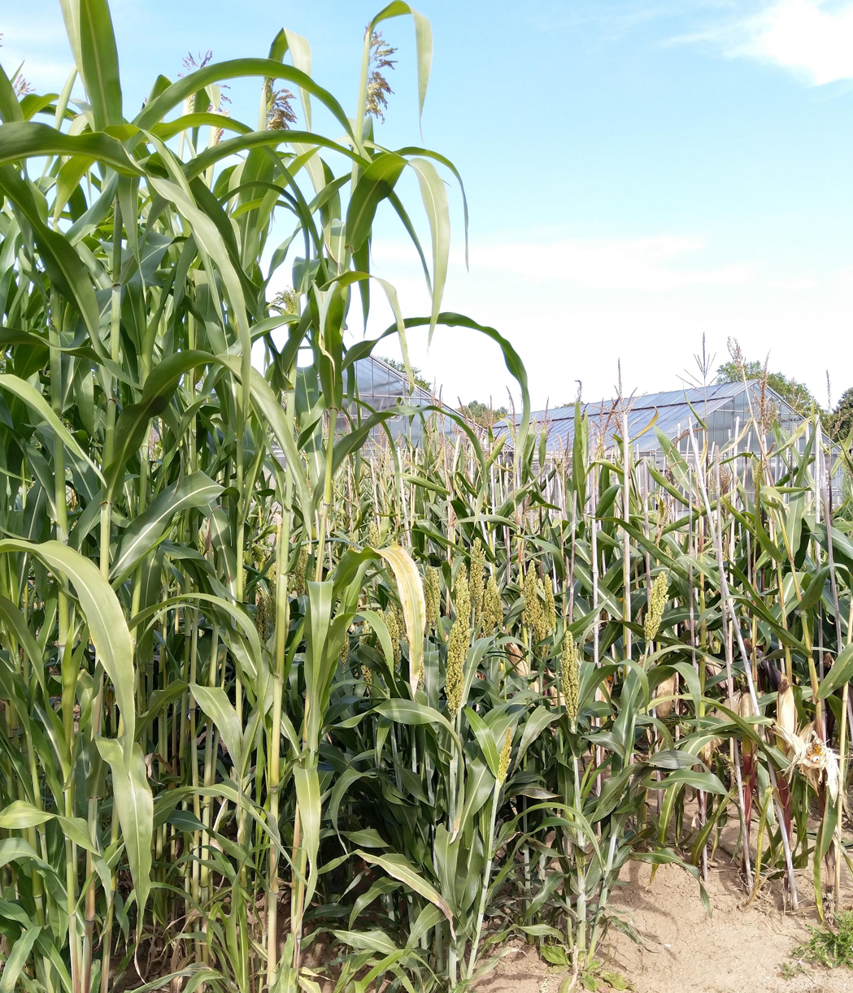
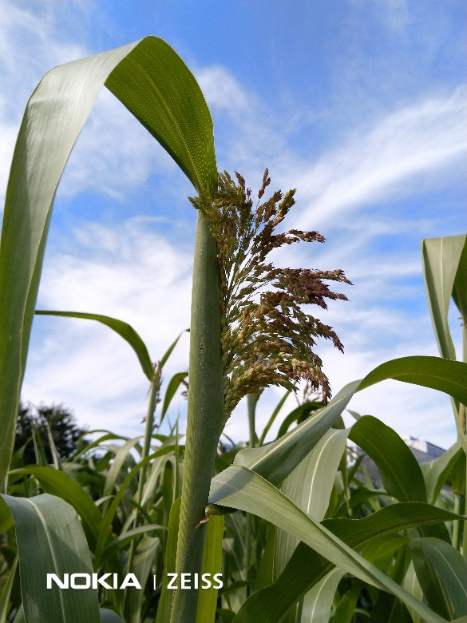
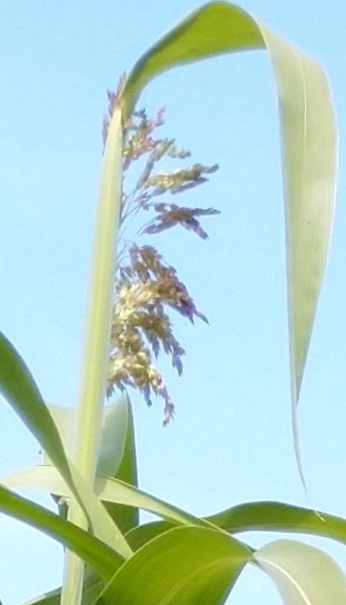
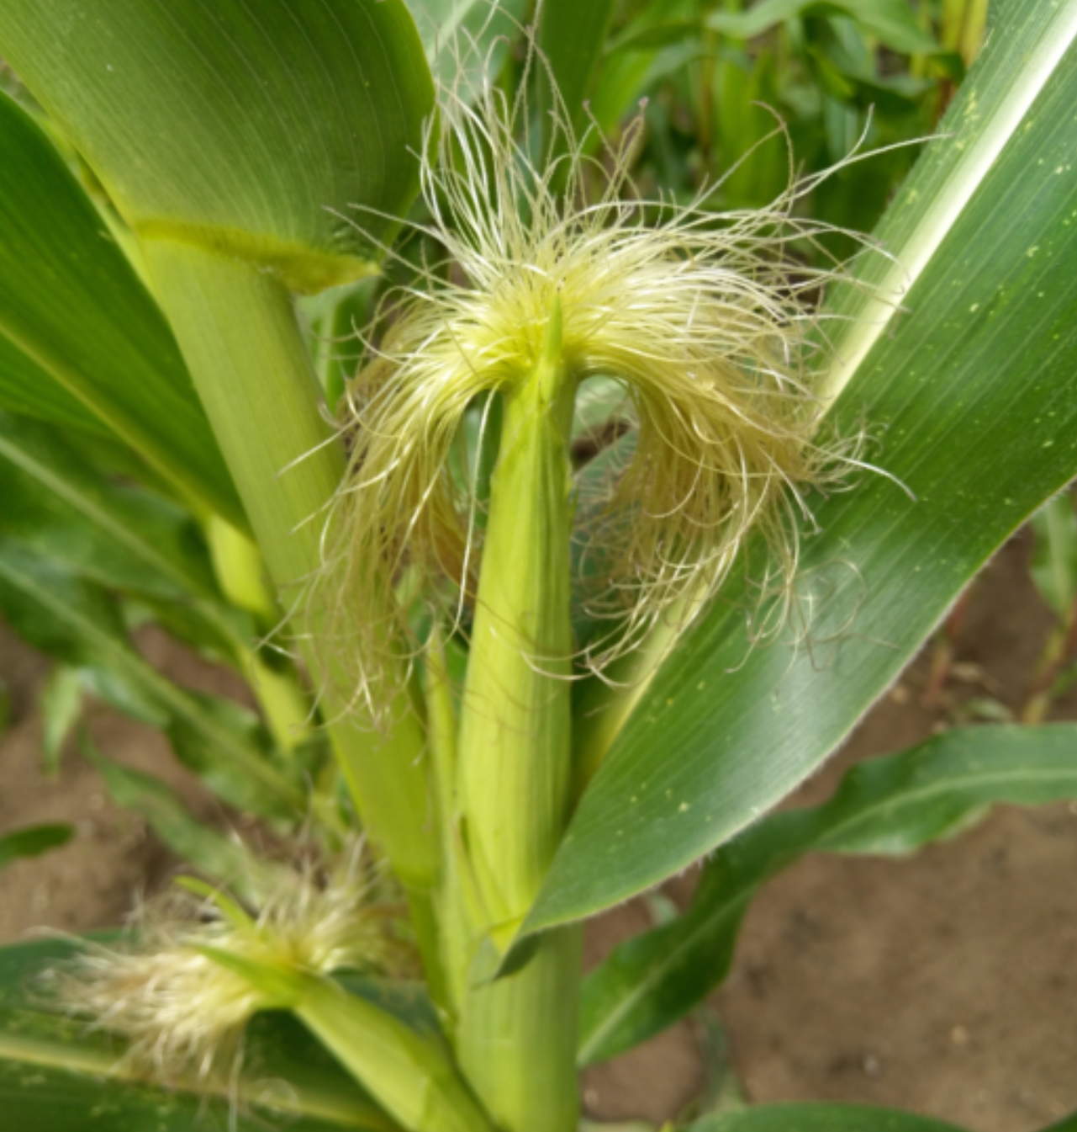
Crossing pairs; ... see, this is ~ between “selfing of initial individuals” and “let them openly mate according to their nature”. Selfing is more costly but avoids the dilution with the general (probably unselected) pollen ‘cloud’. But selfing leads to inbreeding which may not be your objective. At which inbreeding level should the cultivar perform, at which inbreeding level do you want to select candidate cultivars? ‘Natural mating’ such as approximate-random mating (or partial outcrossing ►sorghum) is cheap; fine. But what about control of paternal side? Dilution? And what about genetic variance, reduced to 25% because all candidates are (in case of random mating) to 50% ‘same’ (half-sibs families). Crossing pairs after all avoids any dilution beyond the ‘pair’. In a certain share of the pairs both parents will be ‘good’; this is impossible with un-managed natural mating. And the inbreeding coefficient of the offspring is probably as should be, unlike after selfing. The genetic variance is basically halved instead of reduced to ¼ ...
8
True pictures with Sorghum and one with Maize ;-)
© W. Link 2025

Slide 9
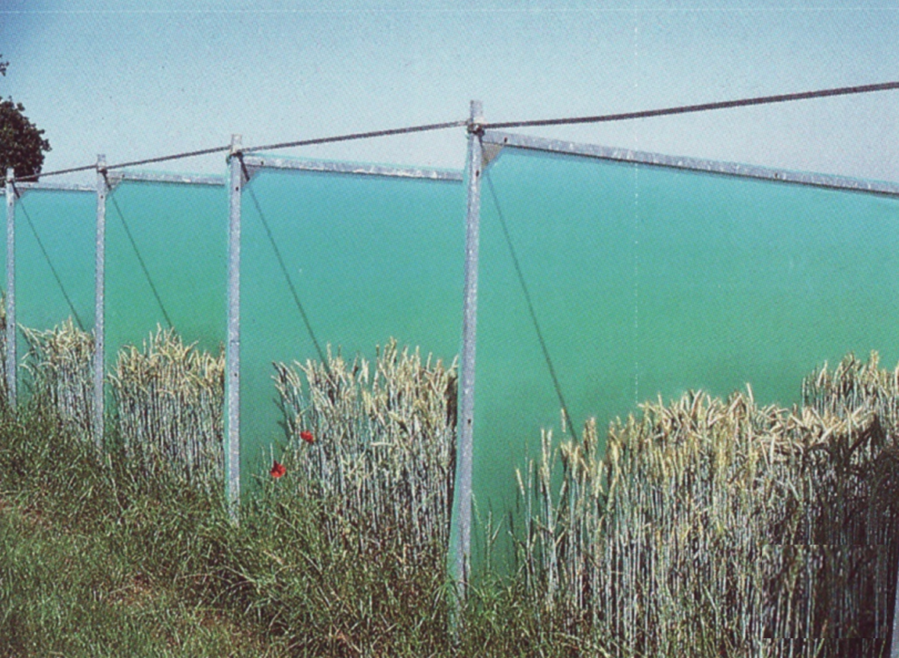
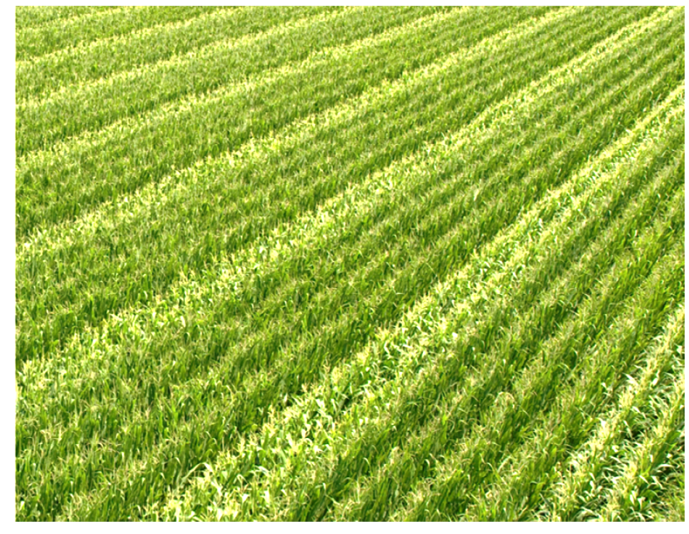

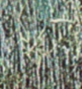
As indicated earlier here: To assess GCA of candidates, tester may be employed as female ♀ or as male ♂.
Left: Setting for rye. One candidate inbred line per cabin pollinates ♂
a central-cabin grown CMS i.e. female tester ♀ .
Right: Maize. Several candidates (emasculated triple-rows ♀) are
‘top-crossed’ by repeated double-rows of one, common pollinator (tester as male ♂).
Courtesy KWS-Lochow (P. Wilde)
9

Slide 10
We now move from ‘inventing’ and comparing Recurrent Selection schemes, i.e., methods, to more basic, more general considerations.
Some advantages of such more general considerations include their long shelf life, long half-life, and late expiration date ... ;-)
10

Slide 11
Melchinger 1980. Lecture in Munich for ‘Biometrie – heute und morgen’
Genetic gain is the larger, the stricter we select, the smaller the (relative) number of the selected ones is.
Data on X-axis was trans-formed to make gain increase linearly.
The fewer we select, the larger is - for heterotic traits - the re-sulting inbreeding depression in the next generation(s).
dt/ha
Total number =100
Genetic gain
2.0
Genetic gain minus Inbreeding depression
1.0
50
40
30
20
10
0
N
… fewer …
-1.0
Inbreeding depression
Find optimum ;-)
-2.0
11

Slide 12
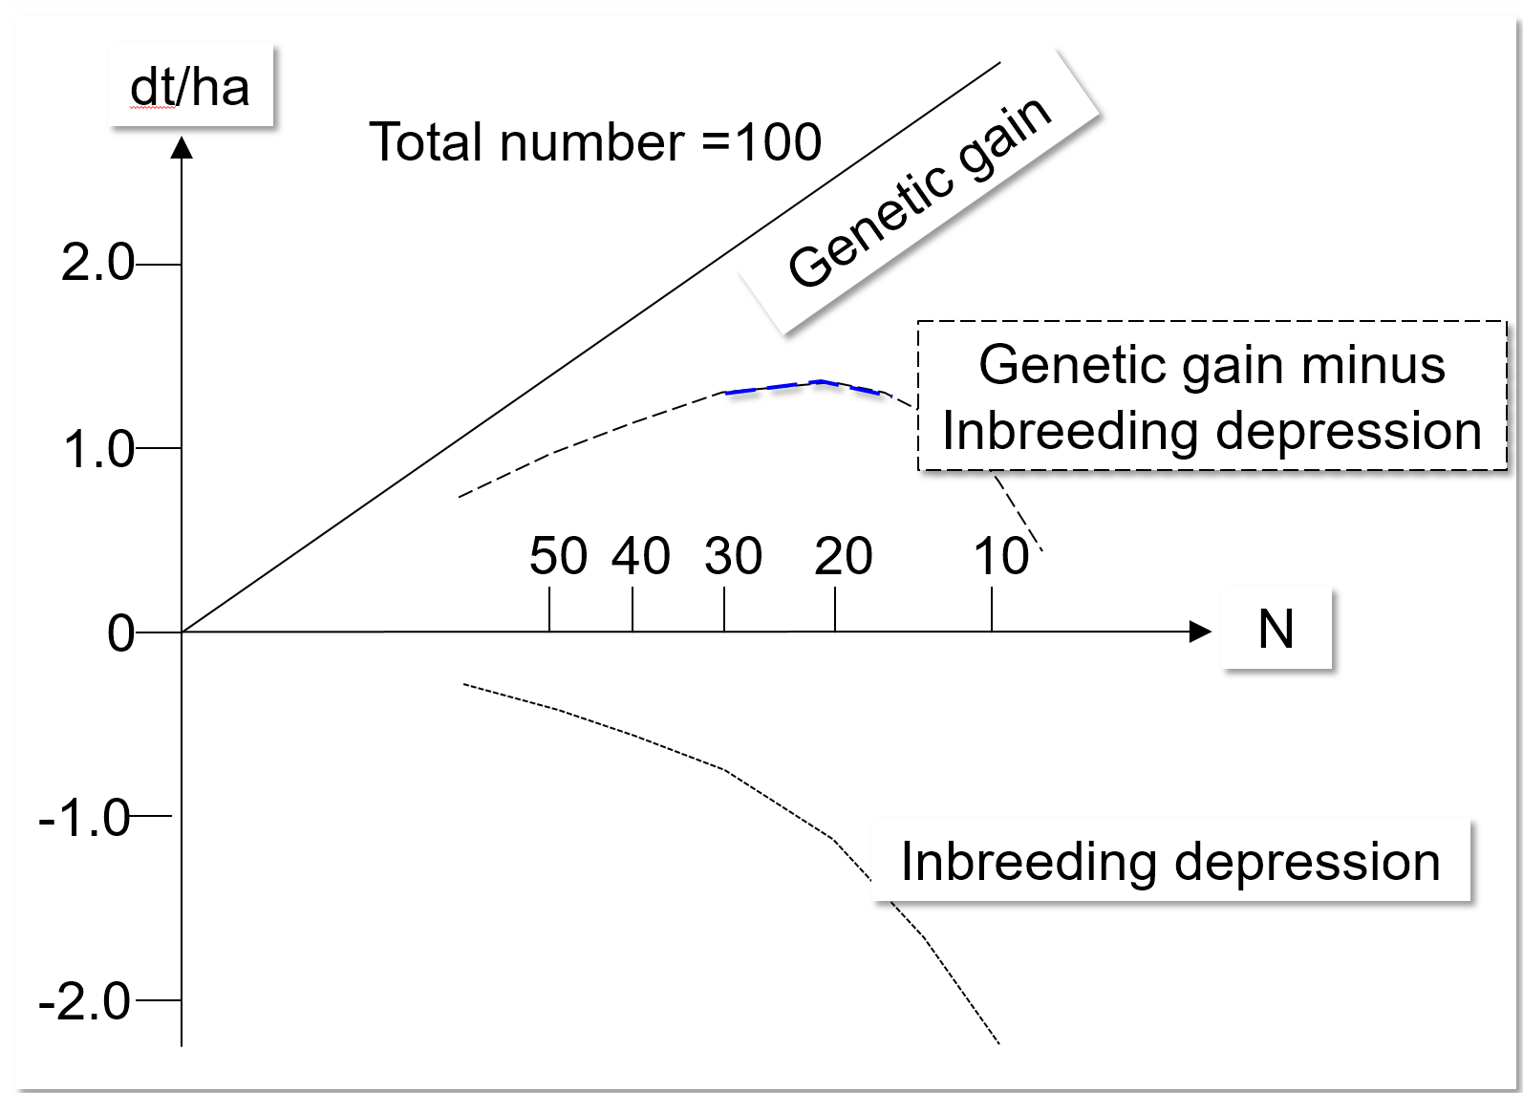
Melchinger 1980. Focus is on gain from one step of Selection
Y-axis shows change per one step of selection.
X-axis shows how rigorous that step of selection was.
Example: N=10≙10 of 100 candidates=10%.
Optimum curve is flat, optimum is between ~15% - 30% (%; strictness aka rigor of selection (Selektionsrate, Selektions-schärfe). In ideal cases, N=N_{e}=effective population size (number of parents of next generation).
Population Genetics: N_{e}=10 leads to an increase of the inbree-ding coefficient of ΔF = 1/(2∙10) = 0.05; the thus-resulting in-breeding depression in trait units is shown.
Cf. UNPLAB-PopGen_Ch-4[Drift I], page 23 ff.
For the sake of longer-term gain (i.e., to preserve diversity), one would try to stay at or left-of-optimum; not right-of-optimum.
12
Mind: X-axis is non-linear here, Melchinger thought it was nicer to have the upper line as linear shape
(see UNPLAB-h²_GxE_Ch-5[BreedersEquation] for ‘Breeders’ Equation’ and ‘Standardized Selection Differential’).
These results fully depend on Pop. Genetics and Quant. Genetics parameter of that trait (grain yield) in that popu-lation. Melchinger took data from Eberhart et al. (1973) & from Hallauer et al. (1973); from the famous BSSS maize population (aka Iowa Stiff Stalk Synthetic).

Slide 13
We move from predicting gain from one step of selection to pondering gain from long-term selection: Gain from a sequence of many selection steps.
This is what Evolution is – yet due to the extremely long time scale, Evolution is barely observable.
This is what Recurrent Selection is; in human time scale but still long-term.
Ponder the differences between artificial selection and natural selection. Artificial selection can include data from previous seasons, from relatives, from DNA and metabolic data et cetera. Natural selection is usually based on the candidate’s phenotype / performance / fitness in given environment.
Natural selection is rarely truncation selection. Nature will rarely make a cut-separation between the chosen ones and the culled ones; even suboptimum genotypes will still contribute to some extent to the future generation. Breeders, in contrast, can apply a strict ‘0-1’ threshold; and they may use the selected ones with equal ‘dose’ although they of course differ in genotypic or breeding value of trait.
13

Slide 14
Naïvely vs. realistically predicted long-term gain from selection, with N=∞ and N<∞
DOI 10.1093/genetics/80.1.205
Best-possible value, theoretical limit
►
N=∞
Top: Predicted cumulative (long-term) gain from selection, if one extrapolates naïvely the one-step results of the ‘Breeder’s Equation’.
Below: Realize the theoretical genetic limit with all loci in all genotypes fixed for ‘better’ allele (you need zero Drift, i.e., N=∞ population size).
Further below: N<∞; some loci are – due to Drift – fixed for the ‘bad’ allele. The theoretically best-possible value is not realized.
Selected
N<∞
Predicted means
Expected Population means
Control; no Sel.
◄Lowest-possible value
As time goes by
t-1
t
∞
0
1
Generations of Selection
14

Slide 15
Naïvely and realistically predicted long-term gain from selection, with N=∞ and N< ∞
(1)
Extrapolation (1) is non-sense, because Selection changes allele frequencies, hence changes variances, hence changes Gain per generation of Selection.
This & more is ignored in (1).
Best-possible value
►
(2)
N=∞
Selected
N<∞
(3)
Predicted means
D
N<∞
Inbr. Depr.
(4)
F_{i}
G
Expected Population means
N≤∞
(5)
F’_{i}
N<∞
Control
Inbr. Depr.
(6)
◄Lowest-possible value
0
1
t-1
t
∞
Generations of selection
15

Slide 16
Naïvely and realistically predicted long-term gain from selection, with N=∞ and N< ∞
(1)
(3): We have to expect a Drift-induced reduction of the naïvely predicted gain (G).
(4) If the traits shows hetero-sis, then N<∞ (Drift) causes an increase of the inbreeding coefficient F_{t}, i.e. additional loss in performance.
The curve (6) for ‘no selec-tion’ (with N<∞ & heterosis), shows a decrease as indica-ted; it runs below the theore-tical control line (5).
Best-possible value
►
(2)
N=∞
Selected
N<∞
(3)
Predicted means
Drift
N<∞
(4)
F_{t}
Inbr. Depr. = d>0
G
Expected Population means
N≤∞
(5)
F_{t}
N<∞
Control
Inbr. Depr.
(6)
◄Lowest-possible value
0
1
t-1
t
∞
Generations of selection
16

Slide 17
Naïvely and realistically predicted long-term gain from selection, with N=∞ and N< ∞
doi.org/10.1093/genetics/80.1.205
With N=∞ (2), even the se-lected fraction is N=∞ and hence even rare alleles will not be lost by Drift – and even rare ‘good’ alleles will be ultimately fixed. Metabolic and physiolo-gical changes between low and high performance and conse-quential changes of allele effects are ignored here. Instead, a constant* effect of each allele through all generation is assumed.
*α = f(p); UNPLAB-QuGen_Ch-6[StatMod I] page 20. Yet, this is not what is discussed here. Instead I was here concerned about the effect of allele frequency change at other loci on the α values of the focal locus or loci.
(1)
Best-possible value
►
(2)
N=∞
Selected
N<∞
(3)
Predicted means
Drift
N<∞
Inbr. Depr.
(4)
F_{i}
G
Expected Population means
N≤∞
(5)
F’_{i}
N<∞
Control
Inbr. Depr.
(6)
◄Lowest-possible value
0
1
t-1
t
∞
Generations of selection
17

Slide 18
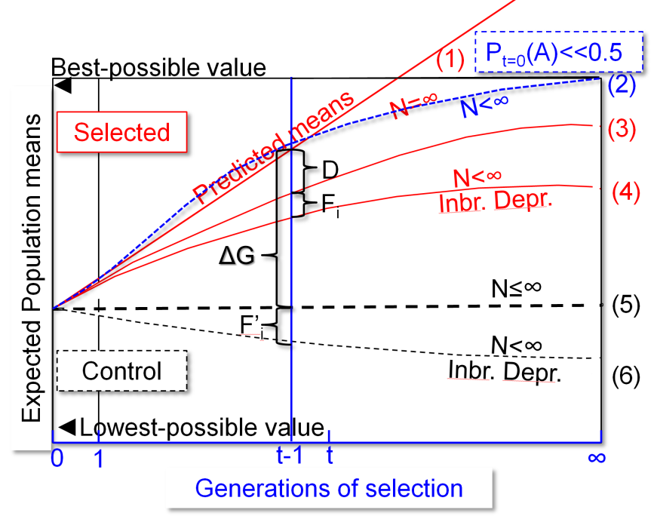
Basic ideas from Wright 1931. DOI 10.1093/genetics/16.2.97
Curve (2) may, in the beginning, run above curve (1): if the ‘good’ alleles are initially very rare; if p(A)<<0.5. Because then, the increase of allele frequency of positive alleles is increasing vari-ance* and thus increasing gain from selection, until p(A)>p_{max}, until selection starts to deplete variance and to shrink further gain (p_{max} depends* on degree of dominance). Performance reduction, caused by accumulating inbreeding (F_{t}) and proportional to
the quantum of the population-trait-generation specific inbreeding depression, will be larger in (6) than in (4). Reason: Selection (4) acts against unfavourable alleles which are thought to cause inbreeding depression, random choice (6) is not doing this.
*Variance is maximum (if two alleles) with p(A)=q(a)=0.5 (well: Additive Variance; compare UNPLAB-QuGen_Ch9[Decomp-GenV II] page 10 ff.)
18

Slide 19
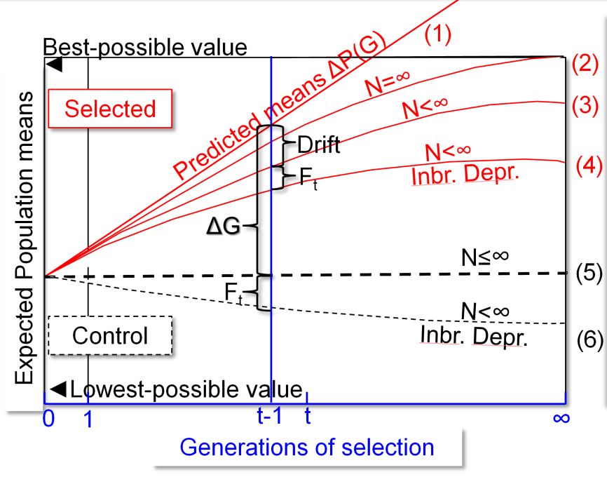
Basic ideas from Wright 1931. DOI 10.1093/genetics/16.2.97
So far, we did not talk about environment. Environ-mental conditions may differ between generations; and/or between replicates of such selection experi-ments. Fluctuating environmental conditions may slow down and even hinder specific adaption to any of the conditions. If environment differs between selection and realizing (verifying) gain from selection, then realized gain may be even negative (see for instance here: DOI 10.1111/pbr.13170).
Restricted fluctuations in environments would allow to increase genetic variance by some share of the GxE variance.
Selection is at times not allowing the selected individuals to have their progeny participate as parents for the next generation with equal opportunity. Therefore, selection causes N_{e} to be smaller than expected from the census N in the selected fraction, i.e., with same N, N_{e} is smaller with selection than without (than with ‘pure Drift’).
19

Slide 20

University of Illinois
at Urbana-Champaign
We now talk about an extremely famous and astonishing long-term experiment
20

Slide 21
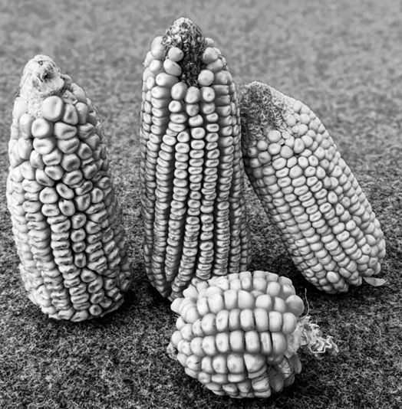
http://mooselab.cropsci.illinois.edu/longterm.htmlLab At Illinois.
DOI: 10.1007/978-0-387-79418-1_25
https://en.wikipedia.org/wiki/Illinois_long-term_selection_experiment
Illinois Long Term Selection Experiment. Selection Response from 1896 through 2016.
40
Dent maize cobs. Notice how the grains are ‘dented’, like molars.
Courtesy of Tim Beissinger
High Protein
25
Grain Protein concentration (%)
Reverse Protein
Low Protein
10
20
60
110
1896
2016
Generations
21

Slide 22
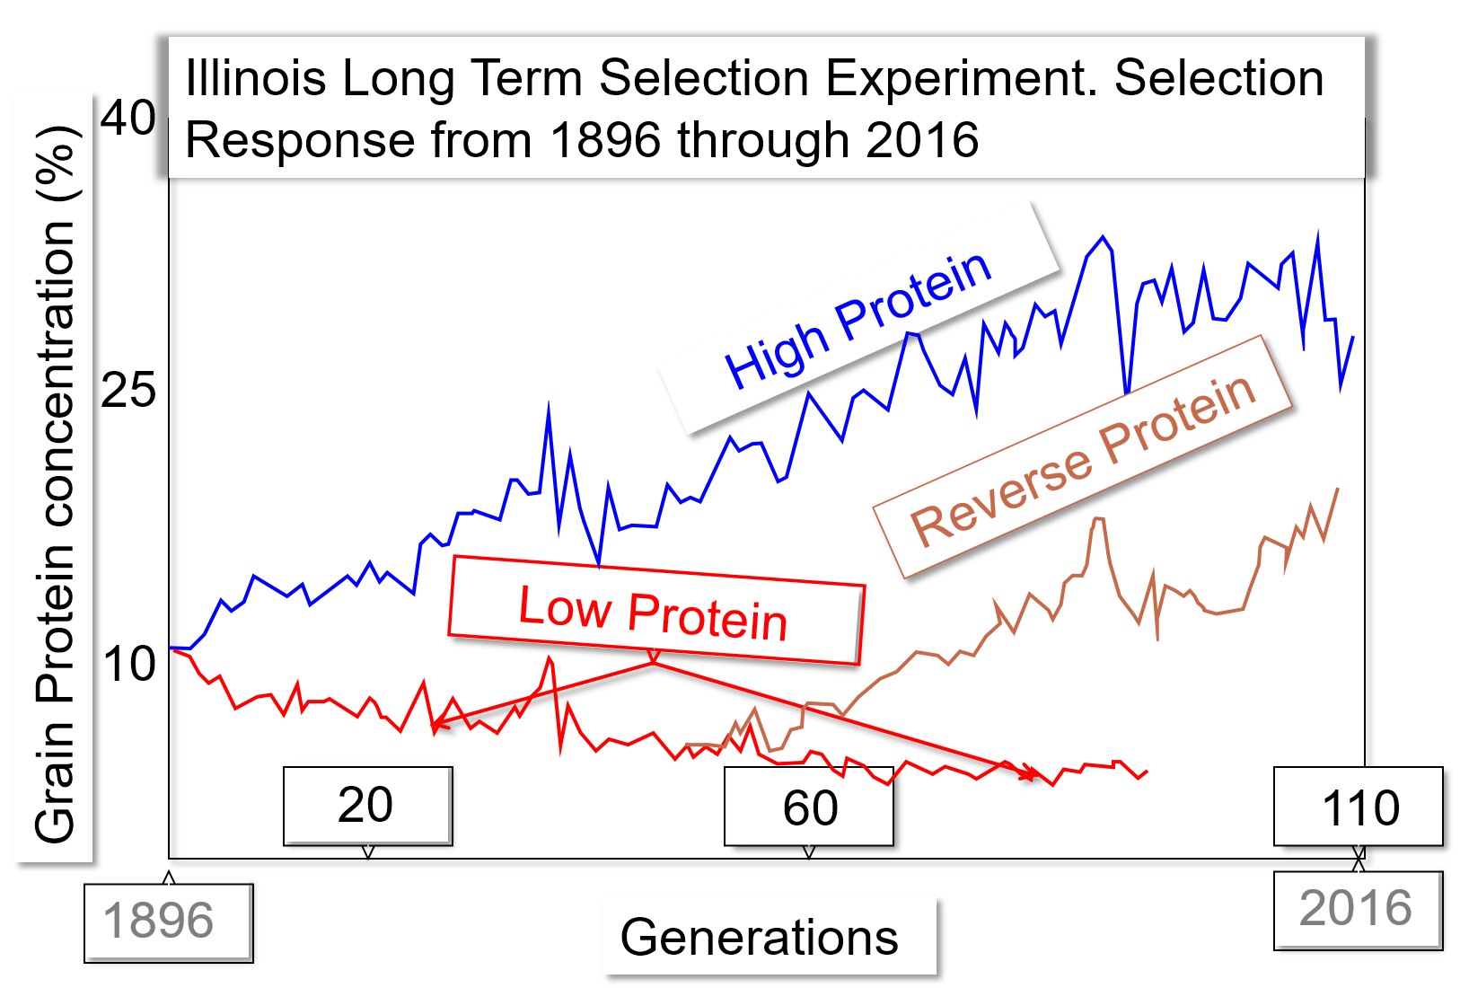
Illinois Long Term Selection Experiment. Selection Response from 1896 through 2016.
From the Quantitative Genetic parameters of the populations in the initial generation, this long-lasting, tremendous change in seed protein content was far from foreseeable, especially employing the Breeders Equation, G = i h² σ²_{P} , (see UNPLAB-h²_GxE_Ch-5[BreedersEquation]). A similar selection with similar outcome was realized for seed oil content. This surprises are not speaking against Quantitative Genetics nor against the Breeder’s Equation, because that Equation ‚predicts‘ gain from one step of selection, not the accumulated gain from several steps.
The grains with high protein content were small, the endosperm volume (starch) was small relative to the reminder (relatively large embryos).
The low protein grains ‘became’ correspondingly large.
Obviously, a minimum protein content is needed to live, you cannot go below it. Even after protein was already at mi-nimum for quite a number of generations („okay, now all ‚low-protein‘-alleles are fixed“) … even from that level, the reverse selection could re-enrich seed protein, and not slower than the still ongoing initial high-protein selection path. There must be very many loci coding for that genetic diversity so that selection pressure per locus (selection coeffi-cient s) is small and so for very many generations, alleles do not become fixed (evolutionary and breeding potential not exhausted for very long time). Learning of other lessons (epistasis … ) is still in the pipeline and pending.
22

Slide 23
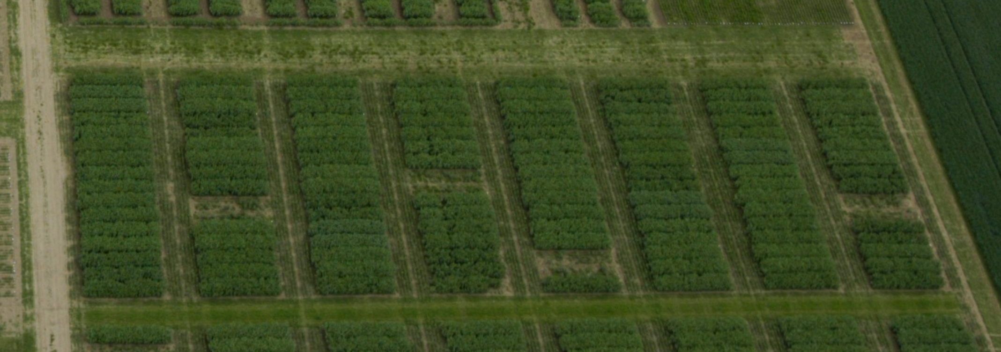
‘Where’ is the genetic variance – a question of utmost importance for realizing gain from selection. ‘Where’ in the sense of ‘either it is between or it is within the candidates’.
23
© Reinshof
https://www.uni-goettingen.de/en/653041.html
Winter faba bean field plots at Reinshof, Göttingen. You see four plots with clear loss of plants due to winter kill. Obviously there are marked differences between the candidates, it is easy to identify the frost-susceptible ones.
As you select between plots, you select between candidates. We have dug up the few survivor plants from the winter-killed plots (nurtured, propagated them): So we intended to exploit even the genetic variance within these four entries (this was meaningful since entries here were genetically heterogeneous).
23

Slide 24
‘Where’ is the genetic variance – a question of utmost importance for realizing Gain from Selection.
Contrasting, homogeneous candidates
See differences (‘variance’) between candidates
See variance within a heterogeneous candidate
24
Selection Unit & Test Unit: If we select between plots or between candidates tested in replicated plots, then the ‘ancestors’ of seed-sown-to-plots ae the Selection Unit (be it an individual, an inbred line, a partial bulk, a narrow population). Test Units (candidates tested in the plots) should be as homogeneous as possible – because this-then will ‘drain’ maximum variance between them (more variance between them ➔ more gain from selecting).
24

Slide 25
‘Where’ is the genetic variance – a question of utmost importance for realizing
Gain from Selection.
Epige-netics?
Hetero-zygosity
Variance ‘within’
The genetic variance is – in simple cases – a fixed quantum (just like ... The First Law of Thermodynamics, the energy conservation)
…
which is always there – somewhere.
Variance (no-Selection-Mutation-Drift-Migration) does not disappear. Yet! For Breeding = for Selection, we need to get things right so that as much as possible the variance occurs between the Selection Units.
Variance ‘between’
Heterozygosity of our candidates (Selection Units) is a source of variance, a potency of future Variance from Segregation. What about the unconventional sources of genetic variance (epigenetics)?
25
25

Slide 26
‘Where’ is the genetic variance – a question of utmost importance for realizing
Gain from selection.
Epige-netics?
Hetero-zygosity
Variance ‘between’
Variance ‘within’
See how the exploitable variance between the candidates has now jumped to be the bigger ☺ slice of the cake.
Heterozygosity of our candidates (Selection Units) is a source of variance, a potency of future variance from segregation. What about the unconventional sources of genetic variance (epigenetics)?
26

Slide 27
Let us conquer a grand-perspective attitude ... where we kind of play with
several of the ‘balls’ that we inspected so far
⚽
⚽
⚽
⚽
⚽
⚽ ⚽
27

Slide 28
Factors that determine the expected Gain from (Recurrent) Selection
Relationship between Test Units and merit of a corresponding Selection Unit
as parent of a cultivar.
Example 1
Selection Units: DH-lines (homozygous)
Test Units: Halfsib-progenies (topcross; tester = own genepool)
Type of cultivar: Synthetic (population) cultivar
In this type of cultivar, the following genetic effects are realized:
● Heterosis within the own genepool
● General Combining Ability (GCA)
The genetic effects that are verified via halfsib testing are the same as those in the target type of cultivar.
Test Unit and cultivar are a the same (zero) inbreeding level.
28

Slide 29
Factors that determine the expected Gain from (Recurrent) Selection
Relationship between Test Units and merit of a corresponding Selection Unit
as parent of a cultivar
Example 2
Selection Units: S₀-plants
Test Units: S₁-lines
Type of cultivar: Single cross hybrid cv.
In this type of cultivar, the following genetic effects are realized:
● Heterosis towards on opposite genepool
● General and Specific Combining ability (GCA + SCA)
The genetic effects that are verified in the S₁-lines are not the same as those in the target type of cultivar.
Test Unit and cultivar are not at the same inbreeding level.
29

Slide 30
Factors that determine the expected gain from (recurrent) selection
Number of years per cycle of selection
Heritability of the trait(s) or (prediction ability)² of the GS-model
(compare UNPLAB-BrMeth_Ch-11[TheFour GS])
Selection Intensity (Drift? Inbreeding Depression?)
Control of male gametes when producing the next generation
● Dilution with male gametes of unselected units [daɪˈluːt]
● Dilution with male gametes of selected but ‚other‘ units
● no Dilution, i.e. full control of male (and female) gametes
Genetic correlation between the
● Genotypic value of a Selection Unit in its merit as
parent of a cultivar … and
● the performance of the Selection Unit
Correlation between the
● the trait under selection and the target trait
● the trait value in the selection environments
and in the target pool of environments
♂
♀
Cycle t
Selection units
Test units
Recombination units
30

Slide 31
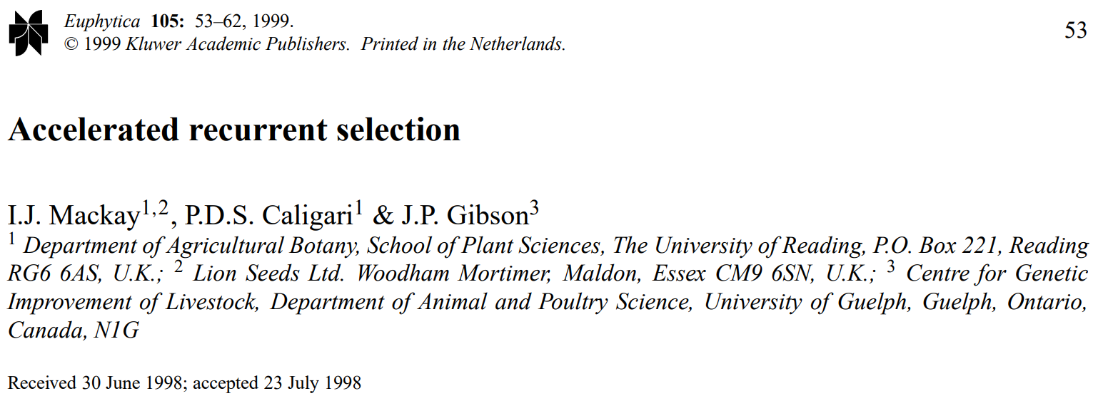
End of Chapter 3.
Further reading
DOI 10.1023/A:1003428430664
Hallauer, A.R., 1992. Recurrent selection in maized. Plant Breeding Reviews 9; 115-179.
DOI: 10.2135/cropsci2016.09.0742
31

Slide 32
From here you may go to UNPLAB-BrMeth_Ch-8[TheFour I]
32
32

